Slide 1
CAP770

Slide 2
AVL tree
AVL tree is a binary search tree in which the difference of heights of left and right subtrees of any node is less than or equal to one.
AVL tree is a self balanced binary search tree.
Balance factor = height Of Left Sub tree – height Of Right Sub tree

Slide 3
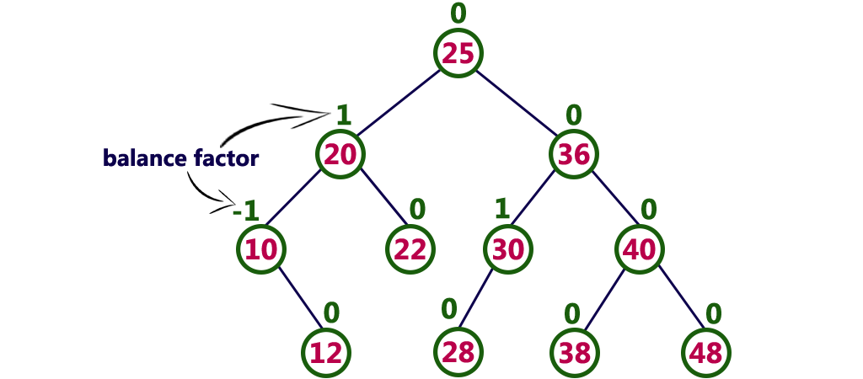
How to find balance factor?

Slide 4
AVL Tree Rotations
Rotation is the process of moving the nodes to either left or right to make tree balanced.
We perform rotation in AVL tree only in case if Balance Factor is other than -1, 0, and 1.
In AVL tree, after performing every operation like insertion and deletion we need to check the balance factor of every node in the tree.

Slide 5
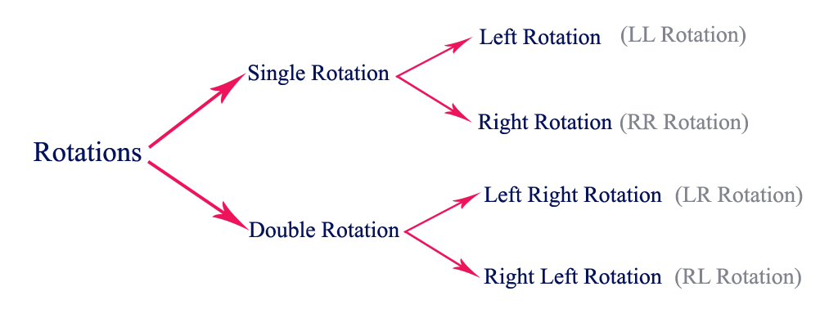
There are four rotations and they are classified into two types:

Slide 6
LL Rotation
When BST becomes unbalanced, due to a node is inserted into the left subtree of the left subtree of node A, then we perform LL rotation, LL rotation is clockwise rotation
50
Trick:
find out node A and B then make A as a child of B
L
40
L
30

Slide 7
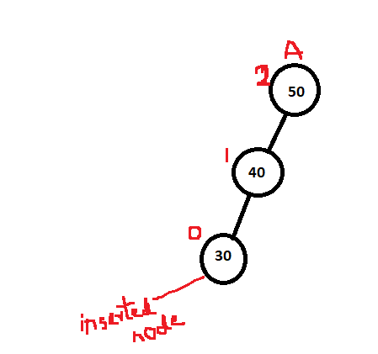
To identify node A:
Find out nearest ancestor of inserted node whose balance factor neither 0,1 or -1

Slide 8
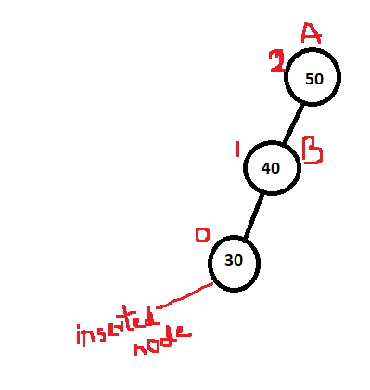
To identify node B:
Find out child of A node which can be left or right child but check which side inserted node is there.

Slide 9
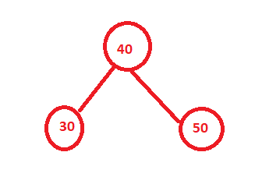
After finding node A and node B now apply:
Trick:
find out node A and B then make A as a child of B

Slide 10
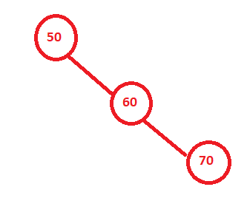
RR Rotation
When BST becomes unbalanced, due to a node is inserted into the right subtree of the right subtree of A, then we perform RR rotation, RR rotation is an anticlockwise rotation
Trick: find out node A and B then make A as a child of B

Slide 11
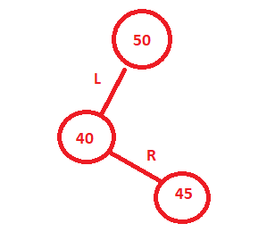
LR Rotation
Inserted node is in the right sub tree of left subtree of node A
In LR Rotation, at first, every node moves one position to the left and one position to right from the current position.
LR rotation = LL rotation + RR rotation
Trick:
Identify A, B, C and then make A, B child of C

Slide 12
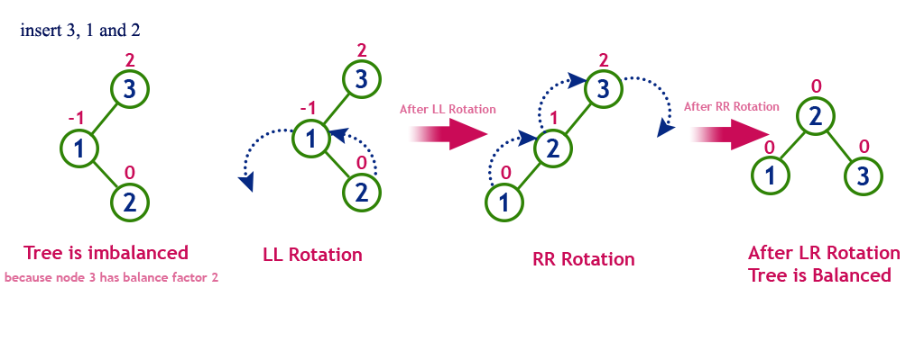

Slide 13
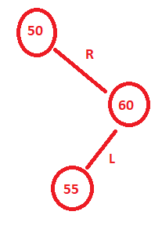
RL rotation:
Inserted node is in the left sub tree of right subtree of node A
In RL Rotation, at first every node moves one position to right and one position to left from the current position.
RL rotation = RR rotation + LL rotation
Trick:
Identify A, B, C and then make A, B child of C

Slide 14
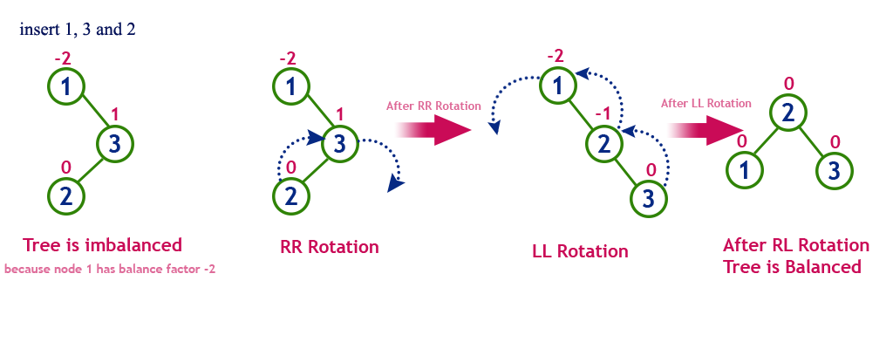

Slide 15
Operations on an AVL Tree
The following operations are performed on AVL tree...
Search
Insertion
Deletion

Slide 16
Insertion Operation in AVL Tree
Algorithm:
Step 1: Insert the new element into the tree using Binary Search Tree insertion logic.
Step 2: After insertion, check the Balance Factor of every node.
Step 3: If the Balance Factor of every node is 0 or 1 or -1 then go for next operation.
Step 4: If the Balance Factor of any node is other than 0 or 1 or -1 then tree is said to be imbalanced. Then perform the suitable Rotation to make it balanced. And go for next operation.

Slide 17
Search Operation in AVL Tree: Algorithm
Step 1: Read the search element from the user
Step 2: Compare, the search element with the value of root node in the tree.
Step 3: If both are matching, then display "Given node found!!!" and terminate the function
Step 4: If both are not matching, then check whether search element is smaller or larger than that node value.
Step 5: If search element is smaller, then continue the search process in left sub tree.
Step 6: If search element is larger, then continue the search process in right sub tree.
Step 7: Repeat the same until we found exact element or we completed with a leaf node
Step 8: If we reach to the node with search value, then display "Element is found" and terminate the function.
Step 9: If we reach to a leaf node and it is also not matching, then display "Element not found" and terminate the function.

Slide 18
Delete operation:
Same as BST delete operation
Check slide for BST operations.

